Slide 1
Medical AI
Lee DongNyoung
Sohaib Abdullah
Pham Van Linh
GROUP 2

Slide 2
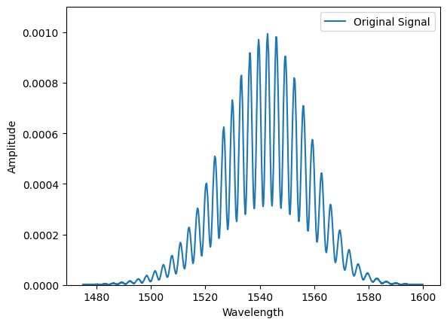
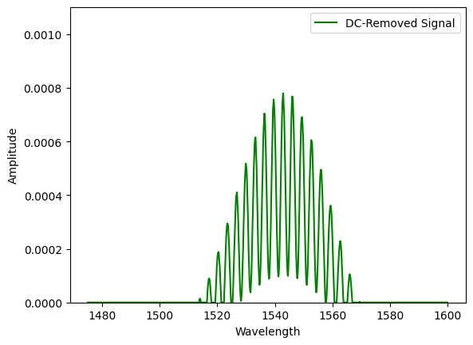
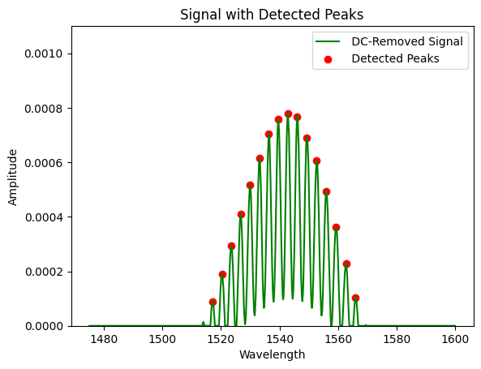
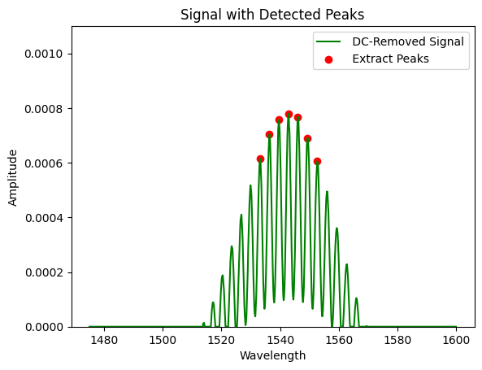
Features from single data
1
2
3
4

Slide 3

stack whole data
Single data
[x₁ x₂ x₃ x… x_{n} y₁ y₂ y₃ y… y_{n}]
Whole data
[x₁ x₂ x₃ x… x_{n} y₁ y₂ y₃ y… y_{n}]₁
[x₁ x₂ x₃ x… x_{n} y₁ y₂ y₃ y… y_{n}]₂
………………………………
[x₁ x₂ x₃ x… x_{n} y₁ y₂ y₃ y… y_{n}]₂₅₀
[x₁ x₂ x₃ x… x_{n} y₁ y₂ y₃ y… y_{n}]₂₅₁

Slide 4
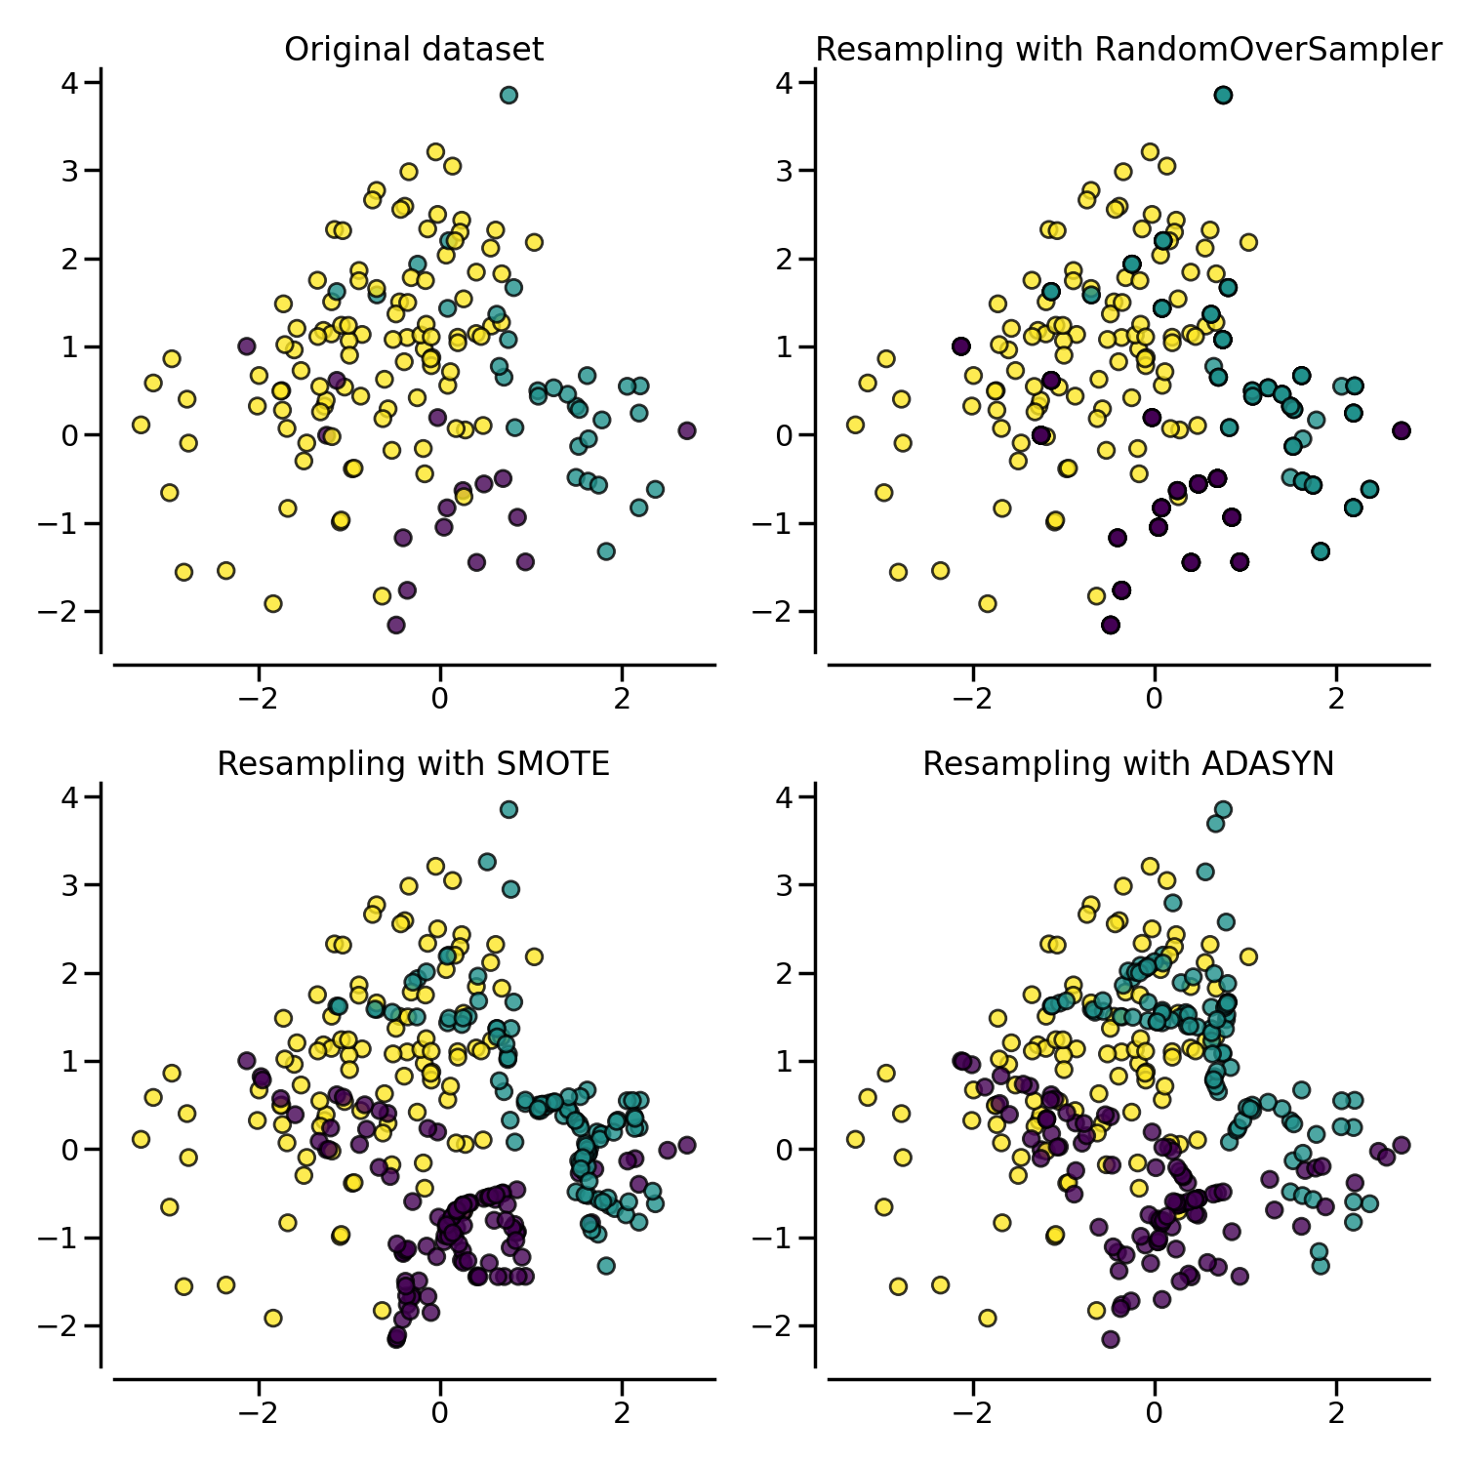
Balancing dataset
label 4: 144
label 2: 72
label 3: 12
label 1: 12
label 0: 11
label 4: 144
label 2: 144
label 3: 144
label 1: 144
label 0: 144

Slide 5
Final dataset
Original data: (251, 50)
features: 25 peaks (Wave length, Amplitude)
[Y_max+1, Y_max-1, X_max+1, X_max-1, ... , X_max, Y_max]
Final data: (720, 50)
each label has 144 data
Label: (251, 1)
2 classification: (0: normal), (1: Worst)
5 classification: (0: normal), (1: Cin1), (2: Cin2), (3: Cin3), (4: Worst)

Slide 6
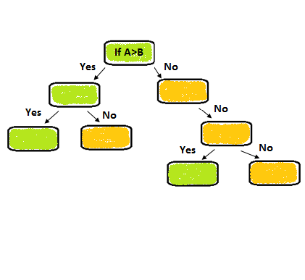
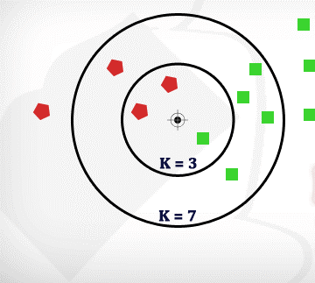
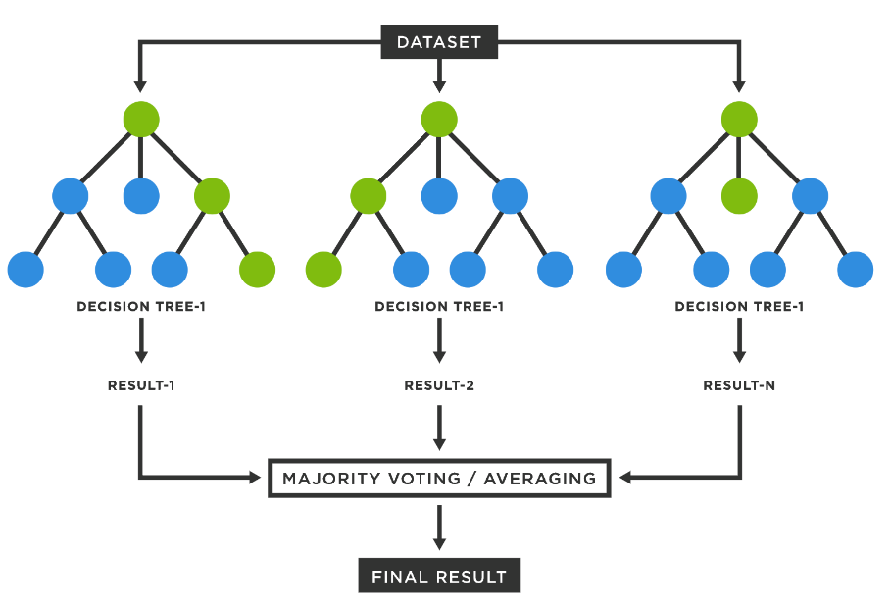
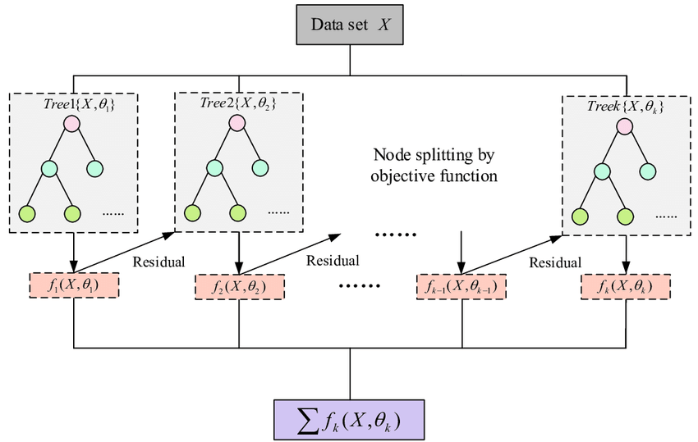
CLASSIFICATION
K-NEAREST NEIGHBORS
DECISION TREE
RANDOM FOREST
GRADIENT BOOSTING
XGBOOST MODEL

Slide 7

CLASSIFICATION Comparison
Model | Over- Sampling Method | Accuracy (%)
 |  | Normal | ClN1 | CIN2 | CIN3 | Worst | Overall
KNN | SMOTE | 97 | 79 | 73 | 96 | 84 | 85.4
 | ADASYN | 00 | 00 | 80 | 67 | 94 | 88.2
DECISION TREE | SMOTE | 100 | 96 | 94 | 100 | 91 | 95.8
 | ADASYN | 100 | 97 | 90 | 100 | 94 | 95.9
RANDOM FOREST | SMOTE | 100 | 100 | 91 | 100 | 97 | 97.2
 | ADASYN | 100 | 100 | 100 | 100 | 97 | 99.3
Gradient BOOSTING | SMOTE | 100 | 96 | 94 | 100 | 88 | 95.1
 | ADASYN | 100 | 100 | 97 | 100 | 94 | 97.9
XGBOOST | SMOTE | 100 | 100 | 100 | 100 | 97 | 99.3
 | ADASYN | 100 | 97 | 97 | 100 | 94 | 97.2

Slide 8
CLASSIFICATION Comparison

Slide 9
regression: RESULTS
Model | Over- Sampling Method | Error
 |  | Mean Absolute Error (MAE)
KNN | SMOTE | 0.12
 | ADASYN | 0.11
DECISION TREE | SMOTE | 0.06
 | ADASYN | 0.06
RANDOM FOREST | SMOTE | 0.05
 | ADASYN | 0.08
Gradient BOOSTING | SMOTE | 0.04
 | ADASYN | 0.06

Slide 10
REGRESSION RESULTS COMPARISON

Slide 11
CLASSIFICATION: Analyze
Model: XGBoost
Oversampling: SMOTE
Data(720, 50), Label(5 classification)
Overall accuracy: 92.10%
Accuracy of each label
Normal(0): 100%
CIN 1(1): 100%
CIN 2(2): 81%
CIN 3(3): 75%
Worst(4): 98%

Slide 12
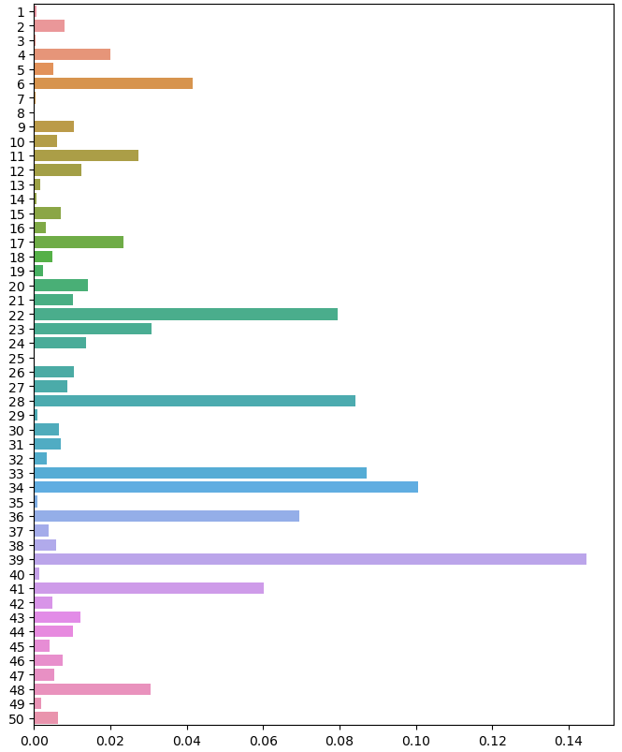
Parameters weight
Top 5
index 39: 14.47%
index 34: 10.08%
index 33: 8.70%
index 28: 8.42%
index 22: 7.94%

Slide 13
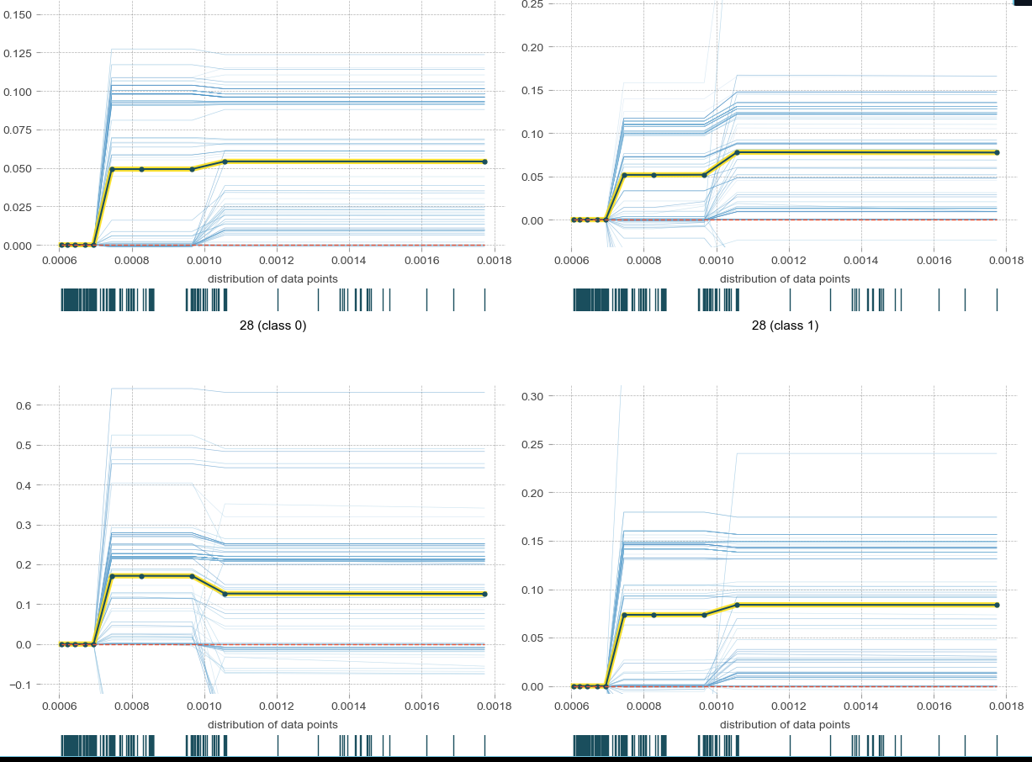
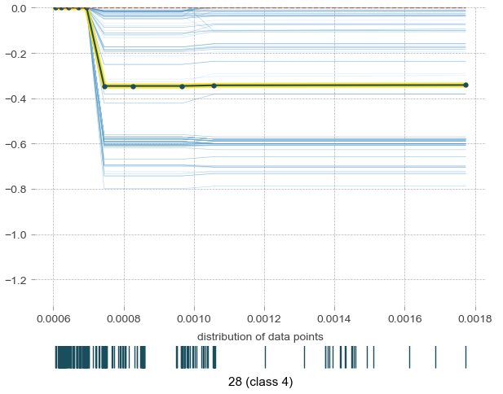
Isolate plot
Index: 28
can detect the ‘worst’ label

Slide 14
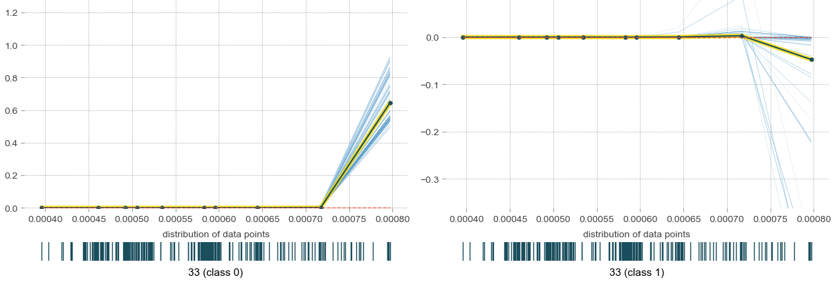
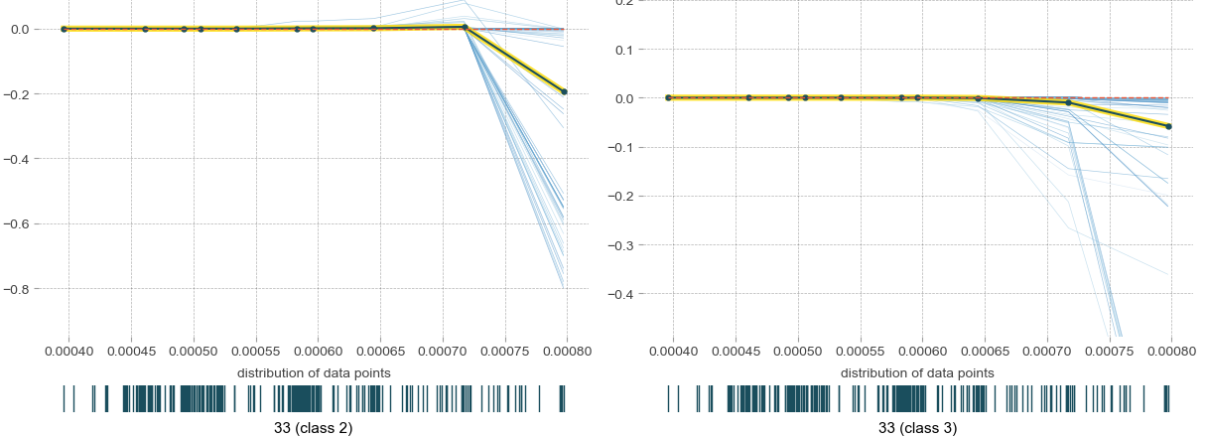
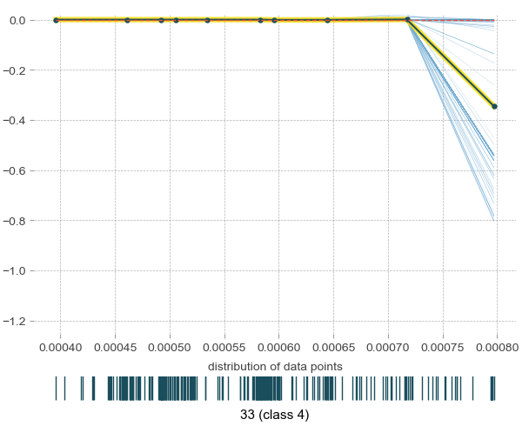
Isolate plot
Index: 33
can detect the ‘normal’ label

